Slide 1
Are We Evil? How to Be Bad and Do Good in the 21st Century
Claire Zabel
czabel@stanford.edu
“The sad truth is that most evil is done by people who never make up their minds to be good or evil.”
― Hannah Arendt, Political Theorist, 1906-1975

Slide 2
Introductions
Me and my biases
How the workshop works
Raise your hand if you don’t understand
Discussion at end
No personal attacks
Name (make a name tent please)
Something you believe in
Favorite thing to do
Something you are excited about

Slide 3
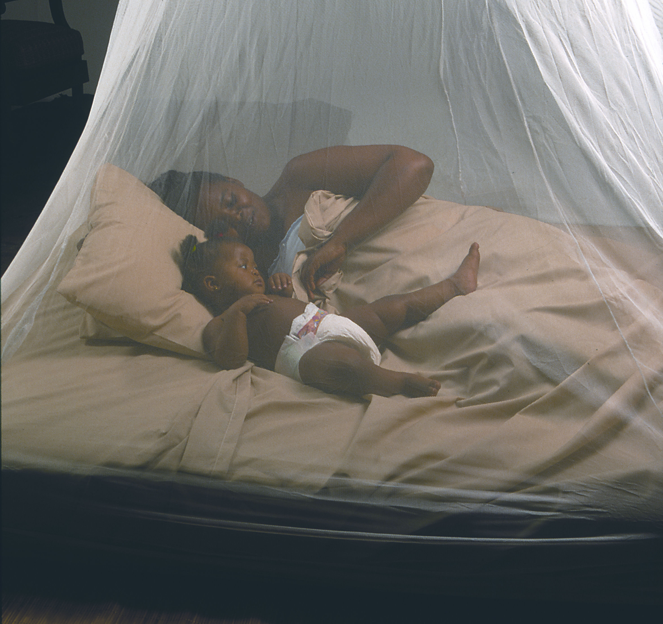
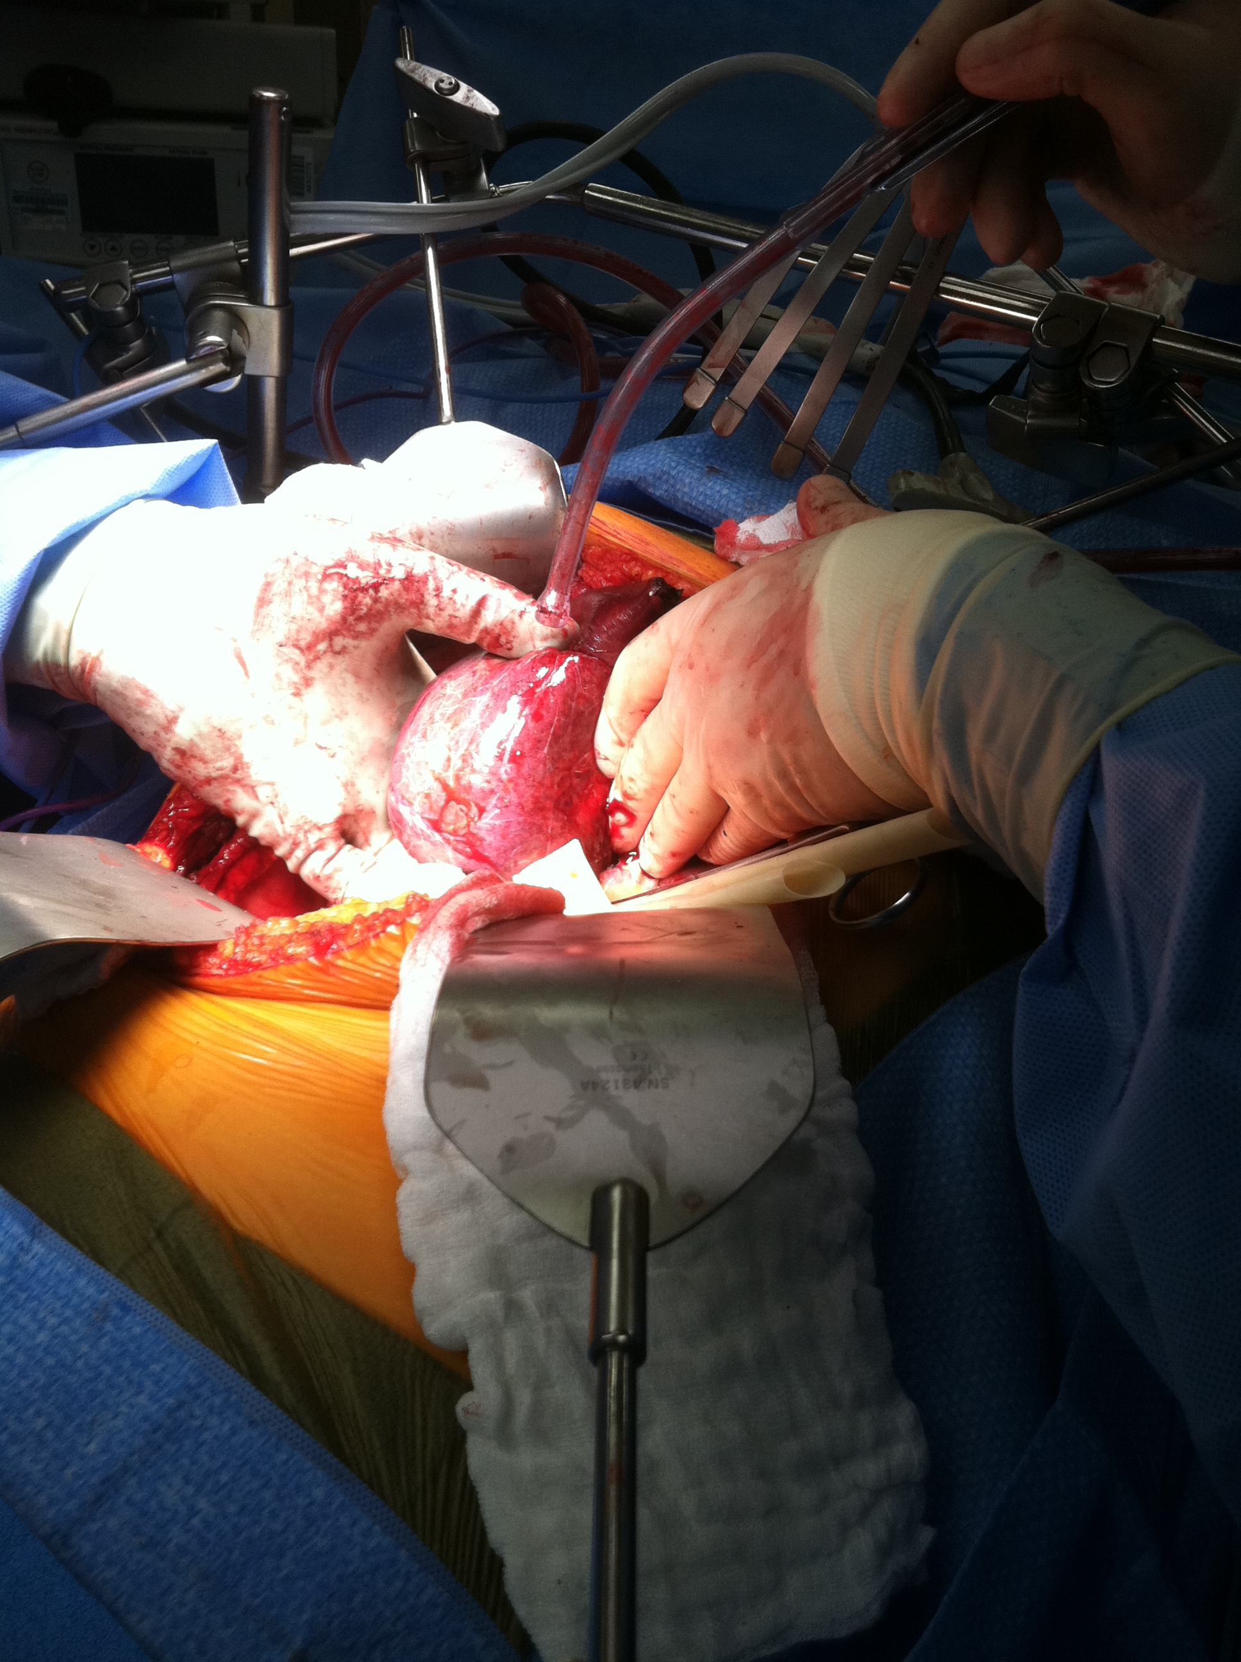
What we are going to talk about
Who we should care about
What we should do about that
Different ways to do good

Slide 4
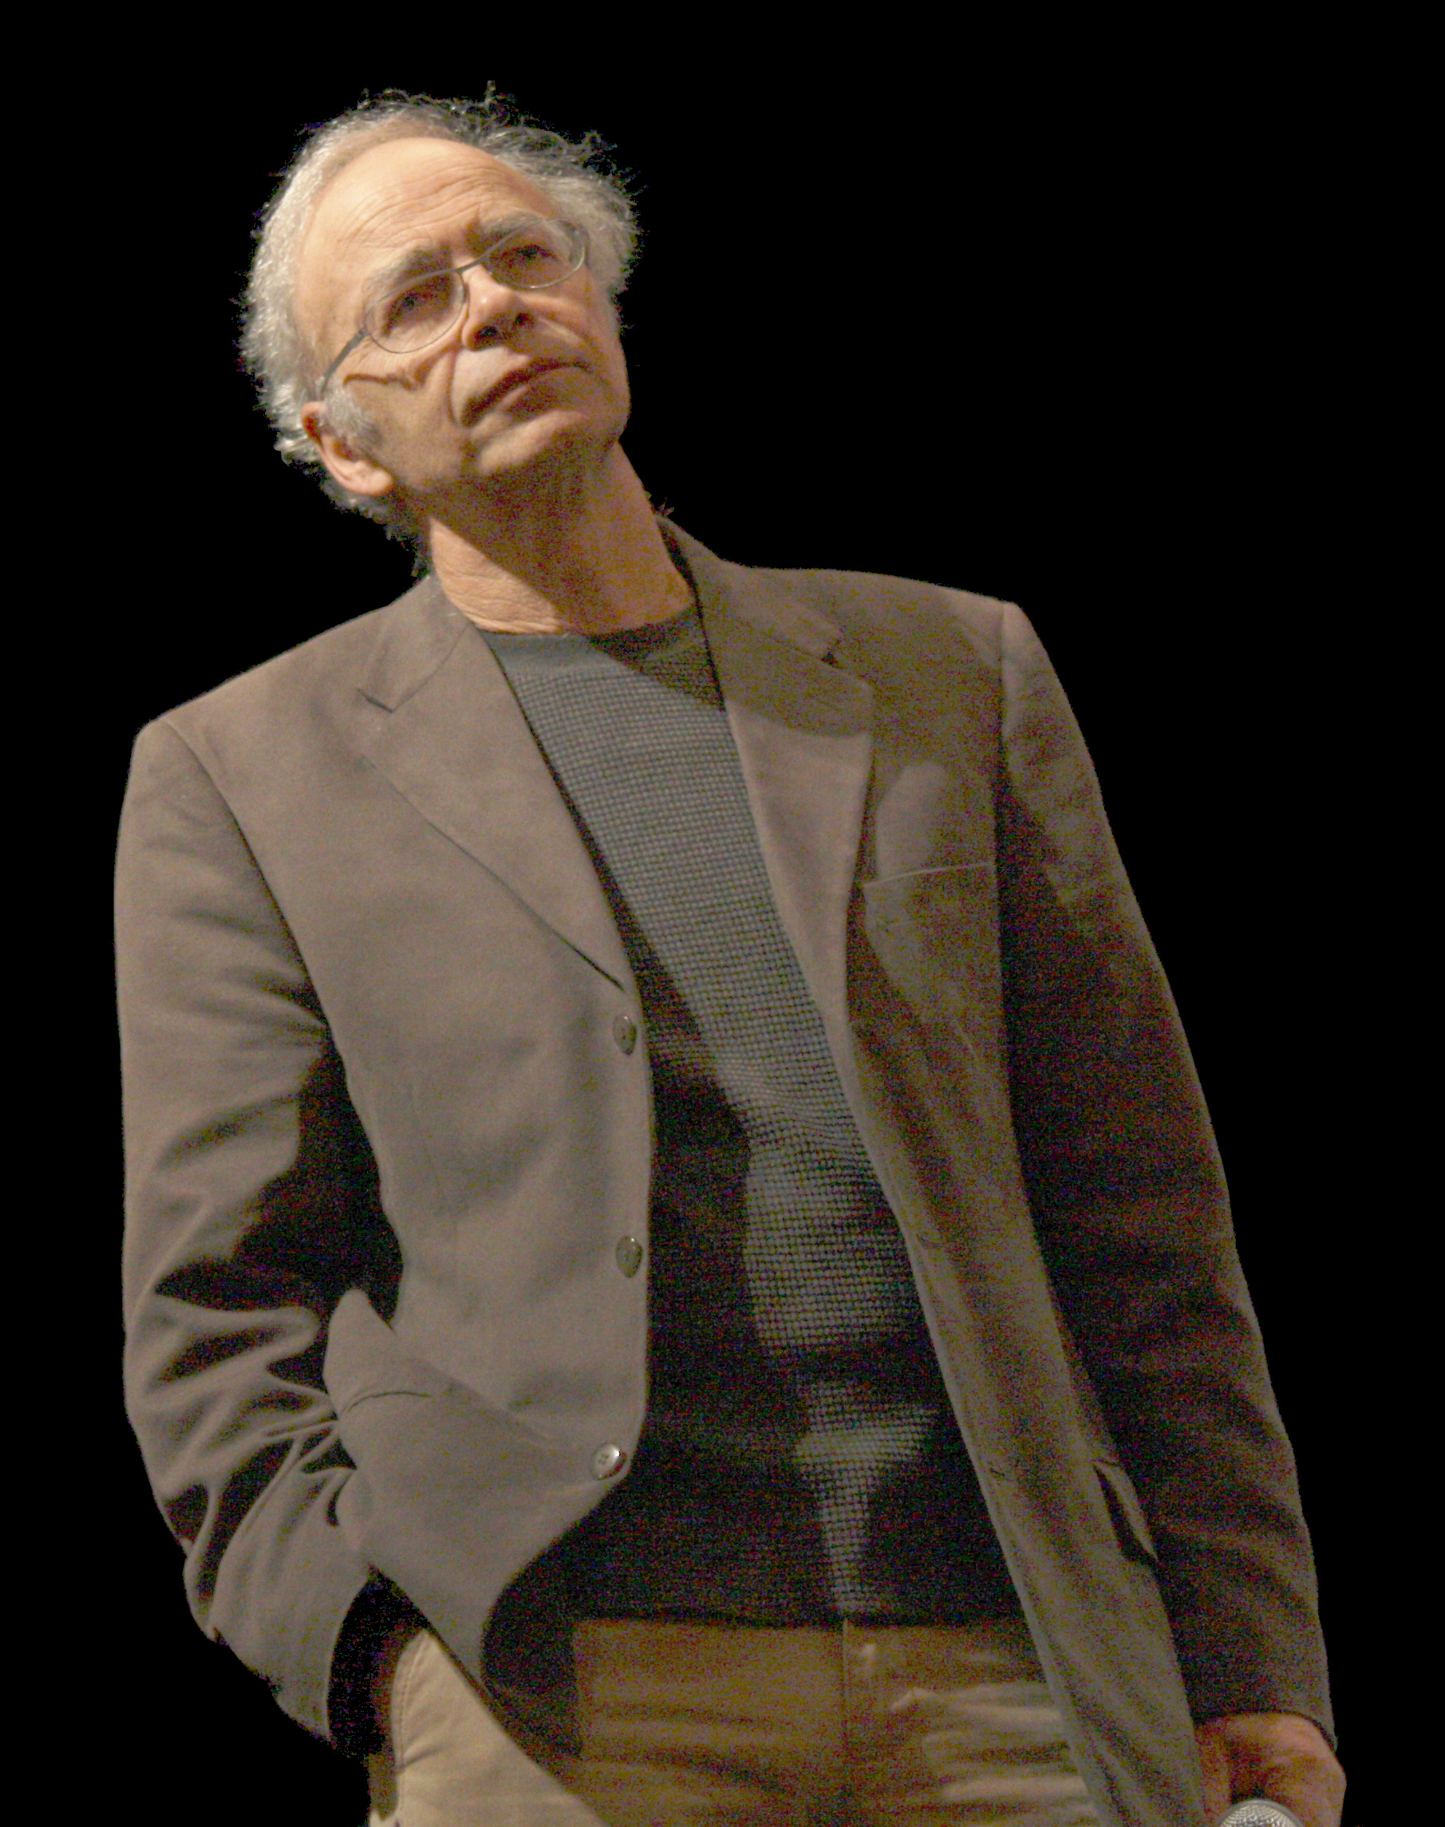
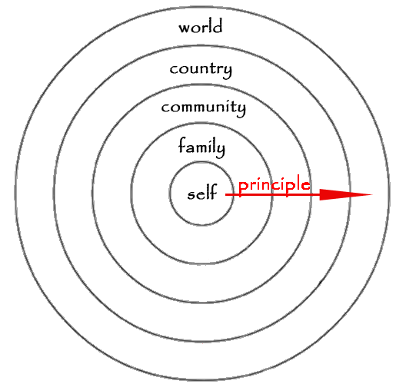
Expanding Circle of Concern

Slide 5
Expanding Circle of Concern
Who was in the circle?
Who is in the circle?
Who should be in the circle?
“The female is as it were a deformed male” – Aristotle, year unknown
“The question before us is, whether [people of African ancestry]...compose a portion of this people, and are constituent members of this sovereignty? We think they are not, and that they are not included, and were not intended to be included, under the word 'citizens' in the Constitution, and can therefore claim none of the rights and privileges which that instrument provides for and secures to citizens of the United States.”- Chief Justice Taney, 1857

Slide 6
Thought Experiment: Gun to the Head

Slide 7
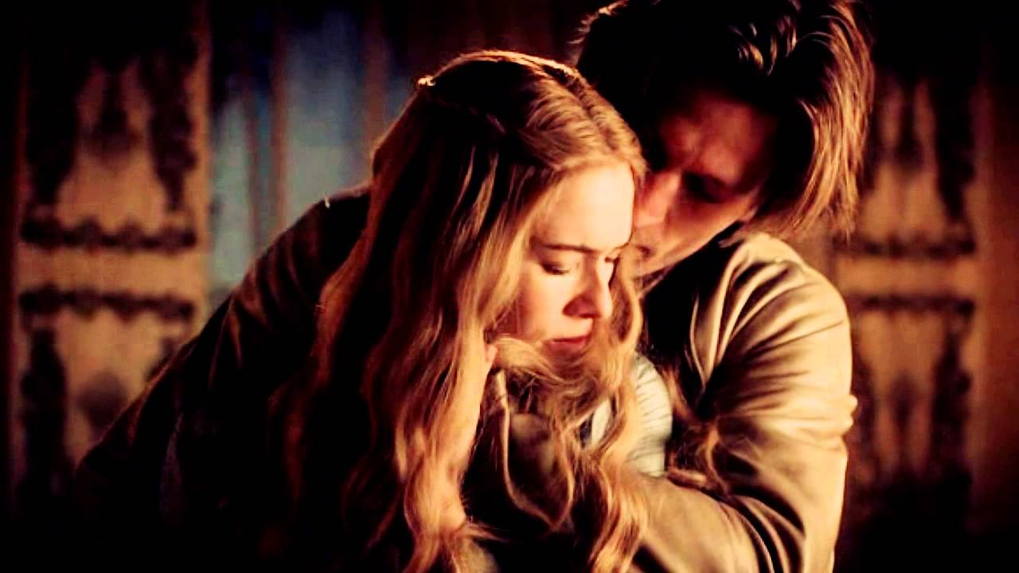
Having Moral Systems
Let’s talk about incest…
“Imagine a brother and sister. They are on a summer holiday and decide that it would be interesting and fun if they tried making love. There’s no chance of offspring because she is using the pill and he a condom. It brings them closer together, but they decide never to do it again.
Is this wrong?”

Slide 8
Utilitarianism in 5 Minutes
Important thing is to maximize utility (maximize happiness, minimize suffering)
Bentham says, "it is the greatest happiness of the greatest number that is the measure of right and wrong” (Jeremy Bentham, 1748-1832)
Other values (justice, spirituality, human dignity) are values for the utility they bring

Slide 9
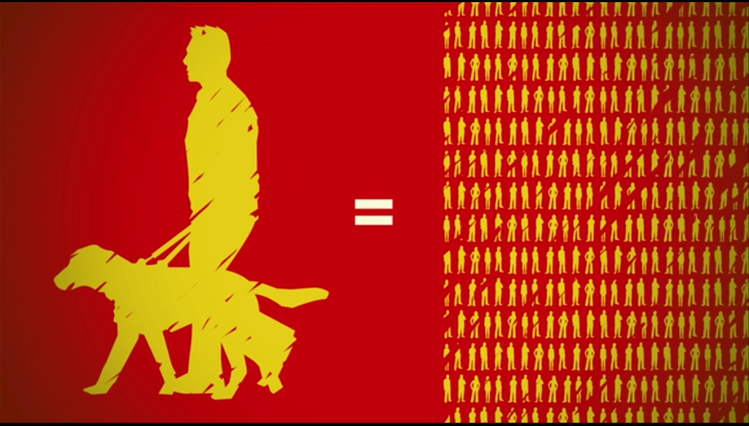
Two Ways to Help the Blind
“If you want to help blind people, you could spend $40,000 training a guide dog to help one person in the US or UK¹. Or, using the same money, you could cure more than 2,000 people of blindness by paying for surgeries to reverse the effects of trachoma in developing countries².”
-Toby Ord, Philosopher, Oxford University
Notes:
1) Guide Dogs of America estimate $19,000 for the training of the dog. When the cost of training the recipient to use the dog is included, the cost doubles to $38,000. Other guide dog providers give similar estimates, for example Seeing Eye estimates a total of $50,000 per person/dog partnership, while Guiding Eyes for the Blind estimates a total of $40,000.
2) Cook et al. (2006), p. 954. Their figure is $7.14 per surgery and with a 77% cure rate.

Slide 10
Effective Altruism
Maximizing positive impact per dollar
Cause prioritization (comparing across causes)
Top causes usually related to extreme poverty, factory farming, or long-term future of humanity
Not all good deeds are created equal. Think American Cheese Society vs. Against Malaria Foundation… What are the implications?

Slide 11
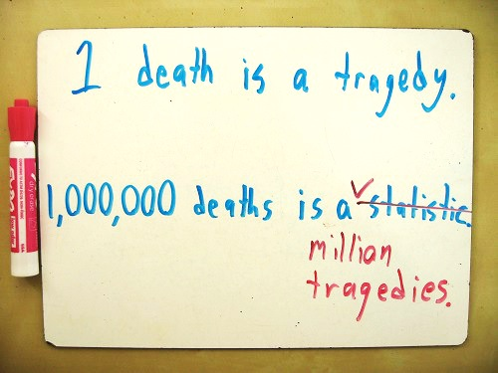
Effective Altruism
Opportunity Costs: There is a limited amount of resources for charity. When resources go to an inefficient charity, that means they don’t go to an efficient one
Disability-Adjusted Life-Year (DALY)
The DALY metric is used to provide a single number to capture all of the health costs caused by a disease (or averted by an aid program). –GiveWell
Used by World Bank, World Health Organization

Slide 12
Earning to Give
Is it wrong for lawyers to volunteer at soup kitchens?
Make an average of $160K/year (=$80/hour) (Glassdoor, 2014)
Salary at nonprofit $45k/year (=$22/hour)(Payscale, 2014)
Pay for other people to work for you?

Slide 13
Replaceability
“If I don’t become a nonprofit worker, someone else will. If I don’t become a lawyer, someone else will, but they won’t donate as much money.”
This is a response to argument that many high-paying careers are socially negative.
Is it better for a lawyer to donate time than money?

Slide 14
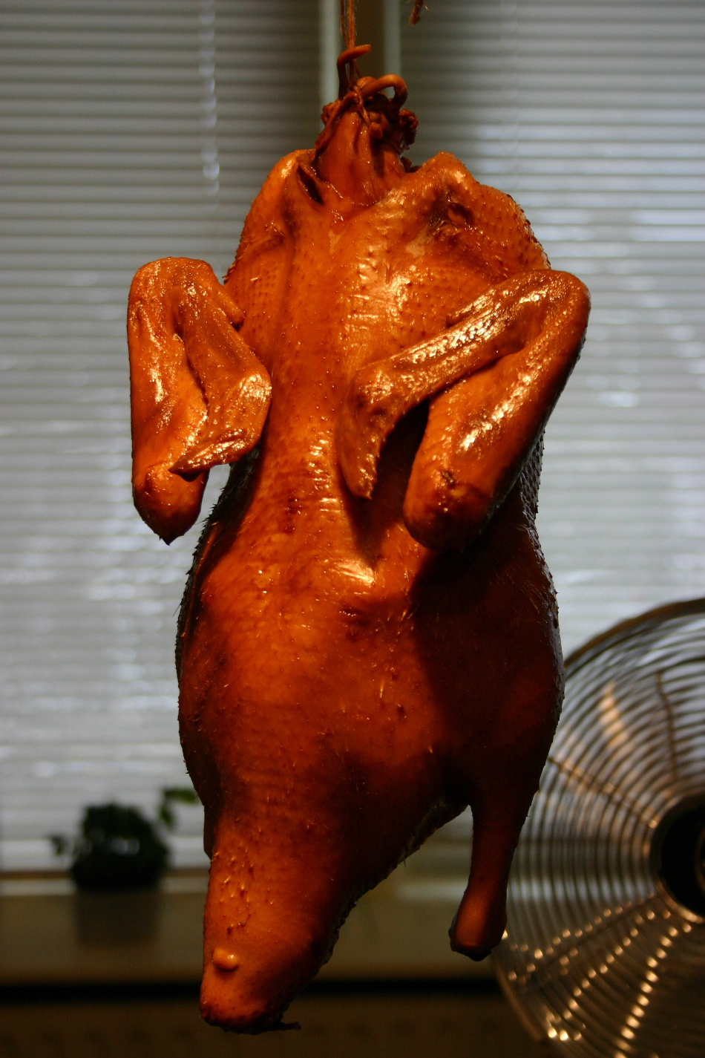
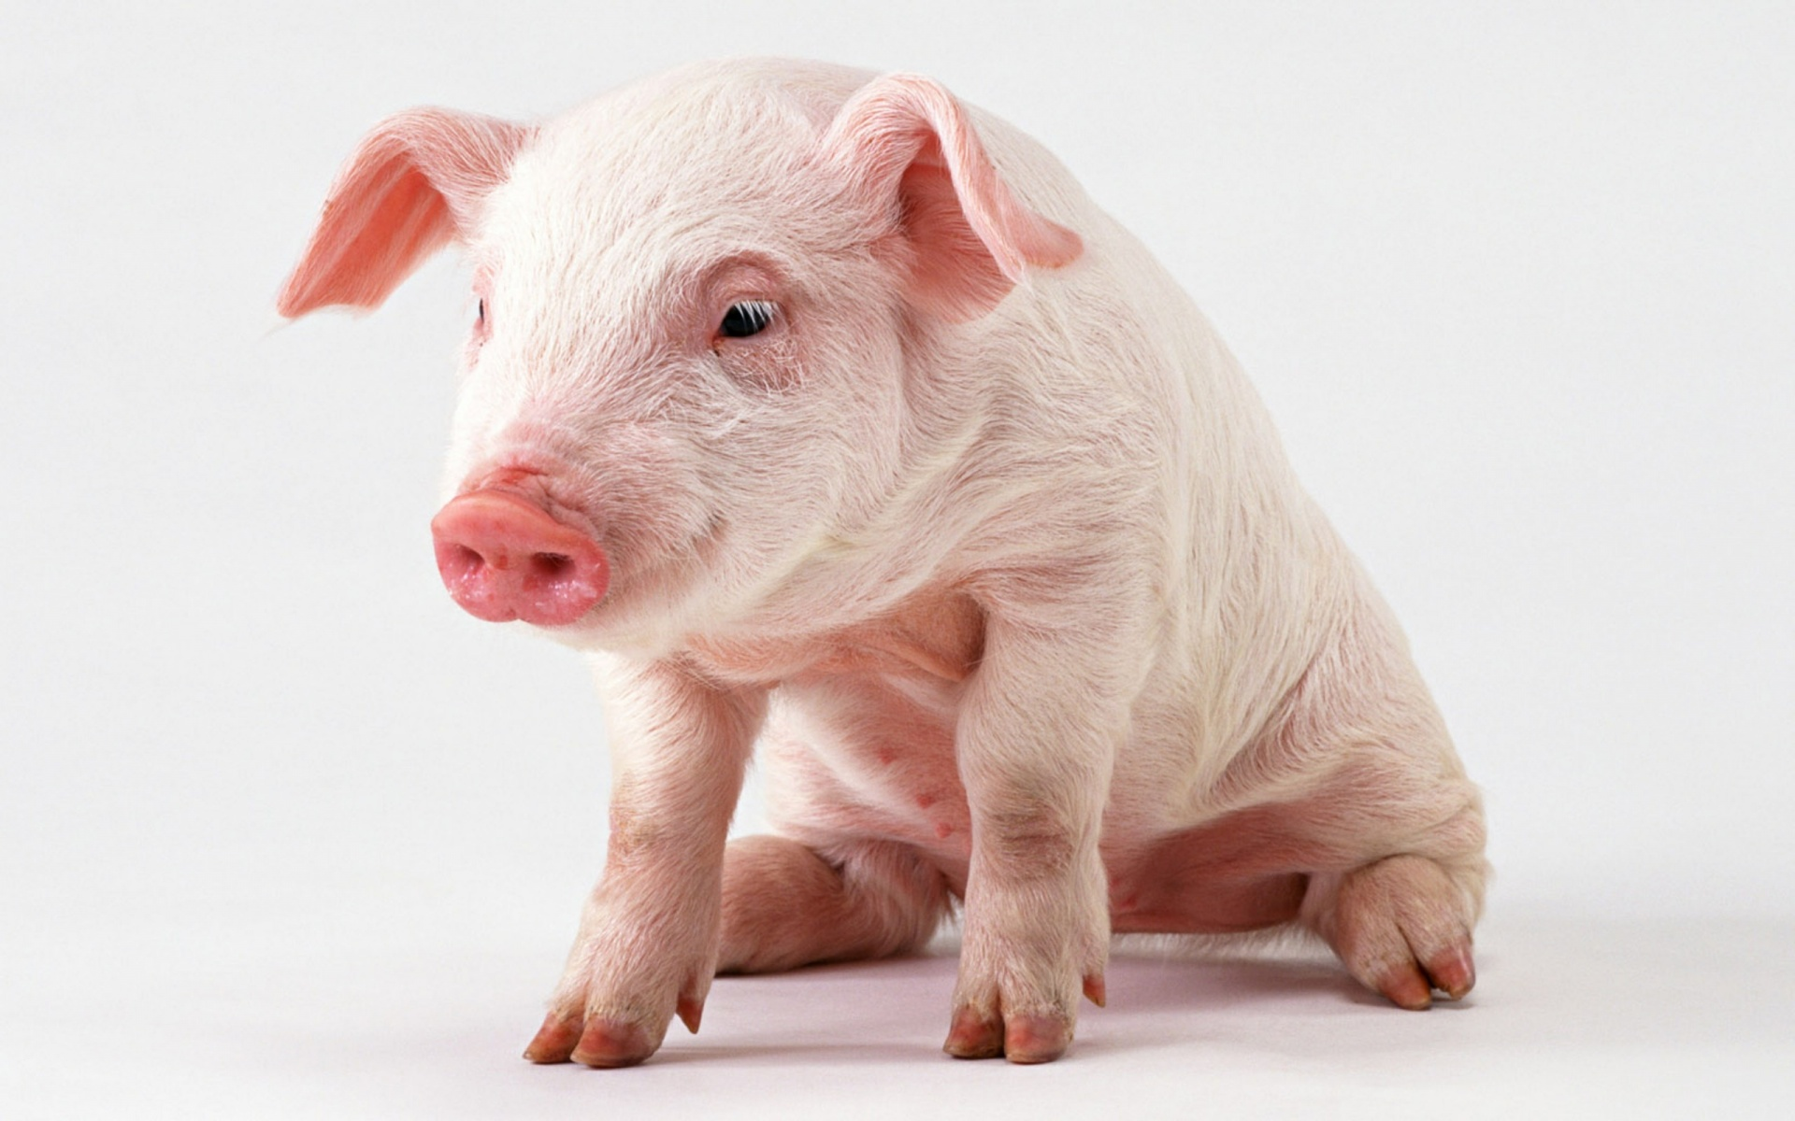
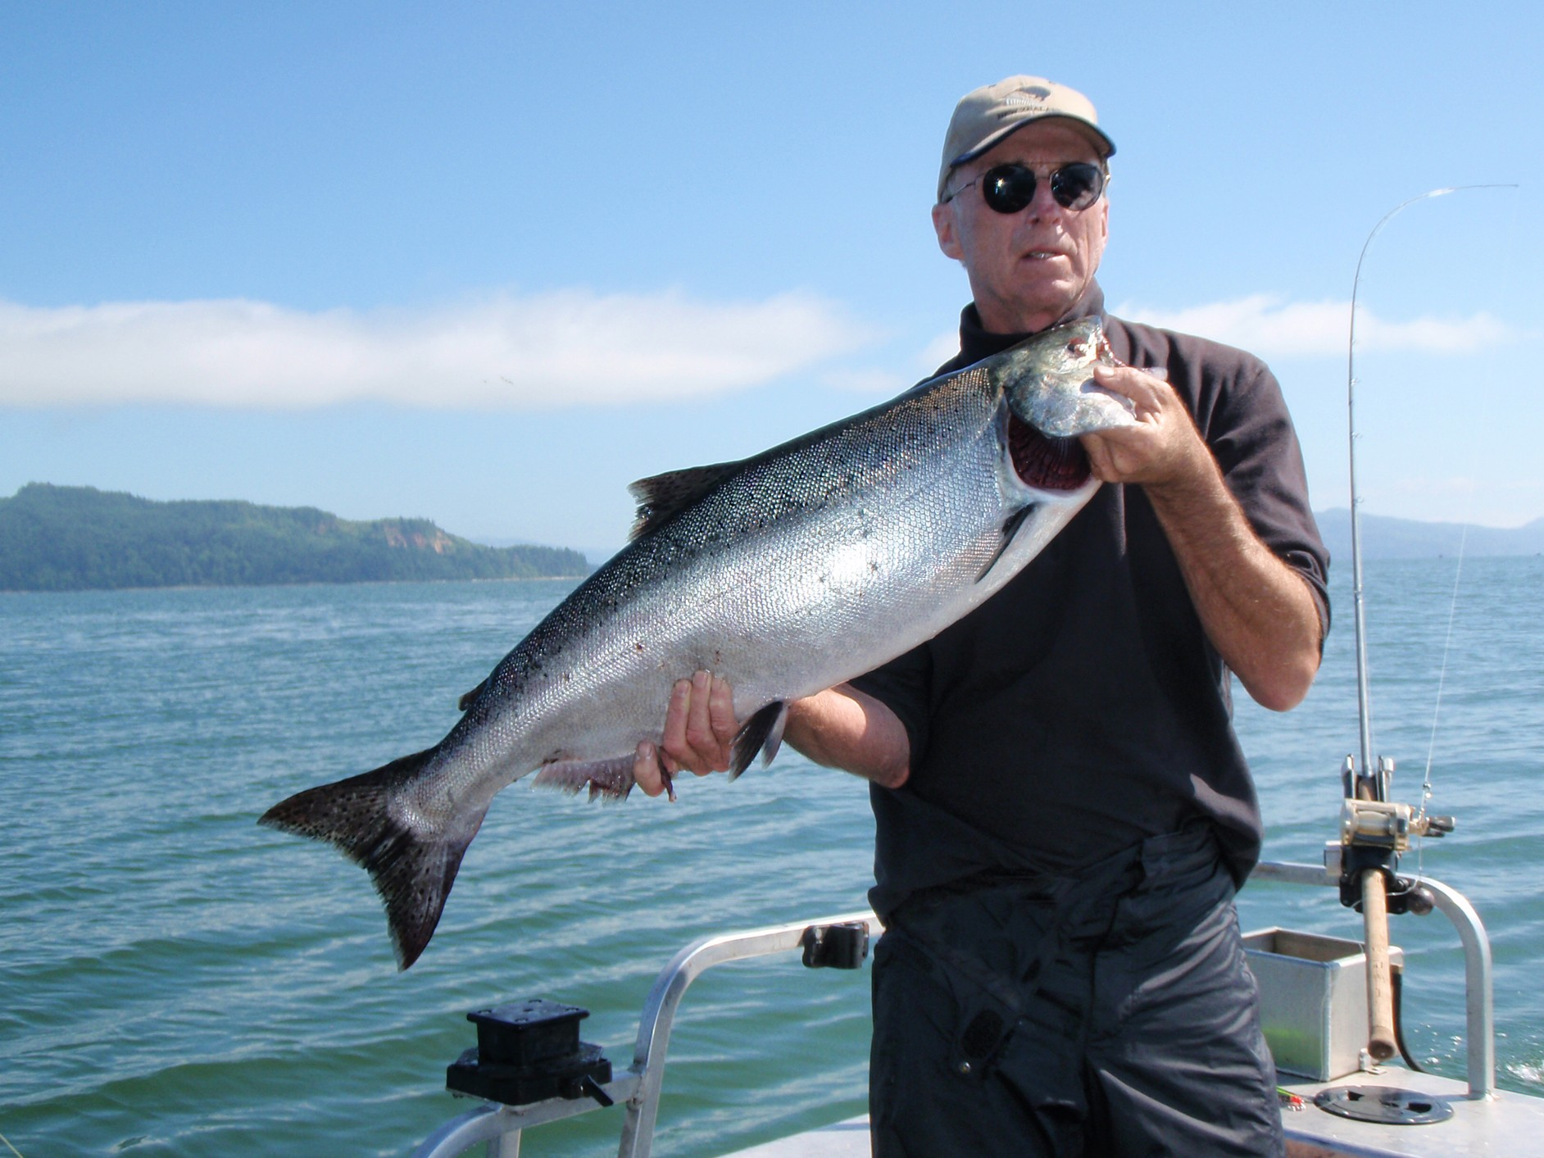
Animals
What is the morally relevant distinction?
Humanity?
Self-awareness?
Emotions?
Ability to feel pain/pleasure?

Slide 15
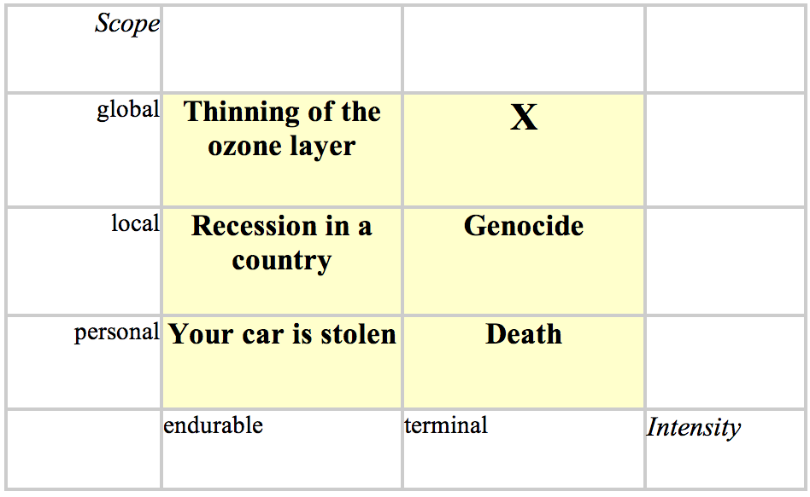
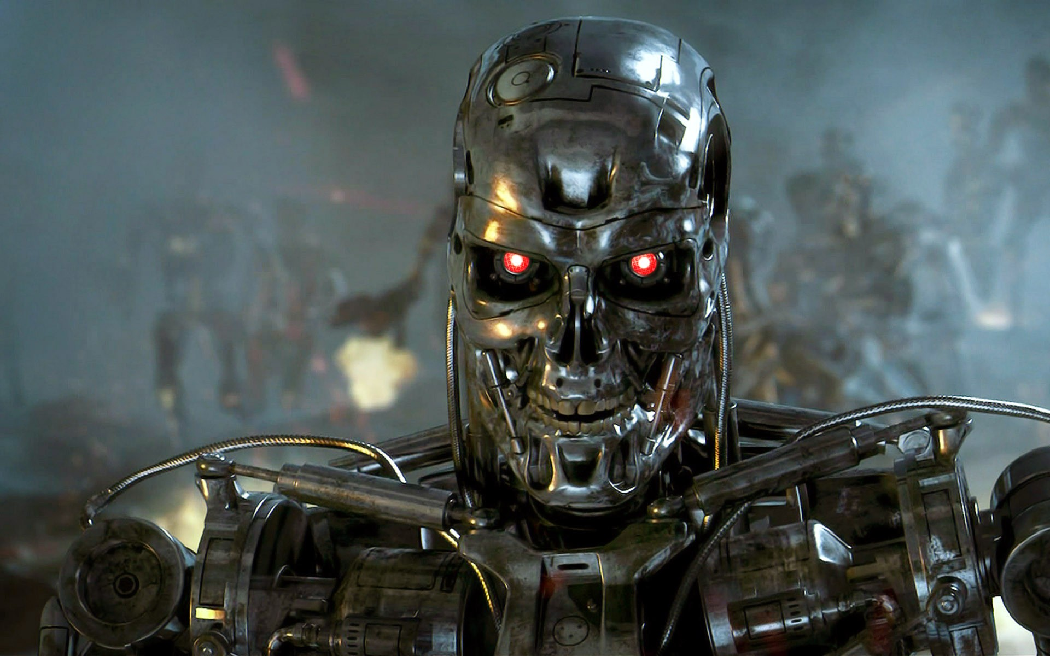
Existential Risk
With the exception of a species-destroying comet or asteroid impact (an extremely rare occurrence), there were probably no significant existential risks in human history until the mid-twentieth century, and certainly none that it was within our power to do something about.
-Nick Bostrom, Philosopher, Oxford University, 2002
Nuclear holocaust
Nanotechnology
Artificial Intelligence
Genetically engineered Disease
Asteroid/comet
Runaway Climate Change

Slide 16
Radical Life Extension
"...I always rejoice to hear of your being still employ'd in experimental Researches into Nature, and of the Success you meet with. The rapid Progress true Science now makes, occasions my regretting sometimes that I was born so soon. It is impossible to imagine the Height to which may be carried, in a thousand years, the Power of Man over Matter. We may perhaps learn to deprive large Masses of their Gravity, and give them absolute Levity, for the sake of easy Transport. Agriculture may diminish its Labor and double its Produce; all Diseases may by sure means be prevented or cured, not excepting even that of Old Age, and our Lives lengthened at pleasure even beyond the antediluvian Standard. O that moral Science were in as fair a way of Improvement, that Men would cease to be Wolves to one another, and that human Beings would at length learn what they now improperly call Humanity!”
-- Benjamin Franklin, Letter to Joseph Priestley, 8 Feb 1780
Personally, I've been hearing all my life about the Serious Philosophical Issues posed by life extension, and my attitude has always been that I'm willing to grapple with those issues for as many centuries as it takes.
-- Patrick Nielsen Hayden
"If you have enough money (for cryonics), then you have enough money to help somebody in need today.”
— Dr. Kenneth Goodman (bioethicist), "Frozen in Time," Miami Herald, Sept. 17, 2002.

Slide 17
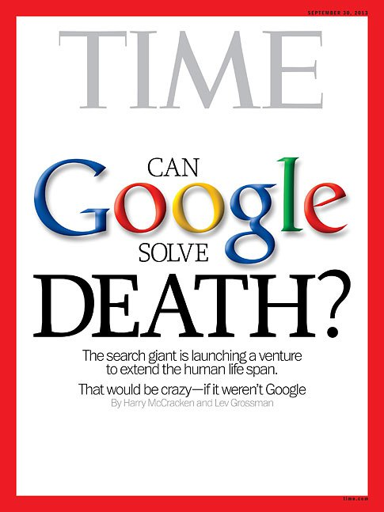
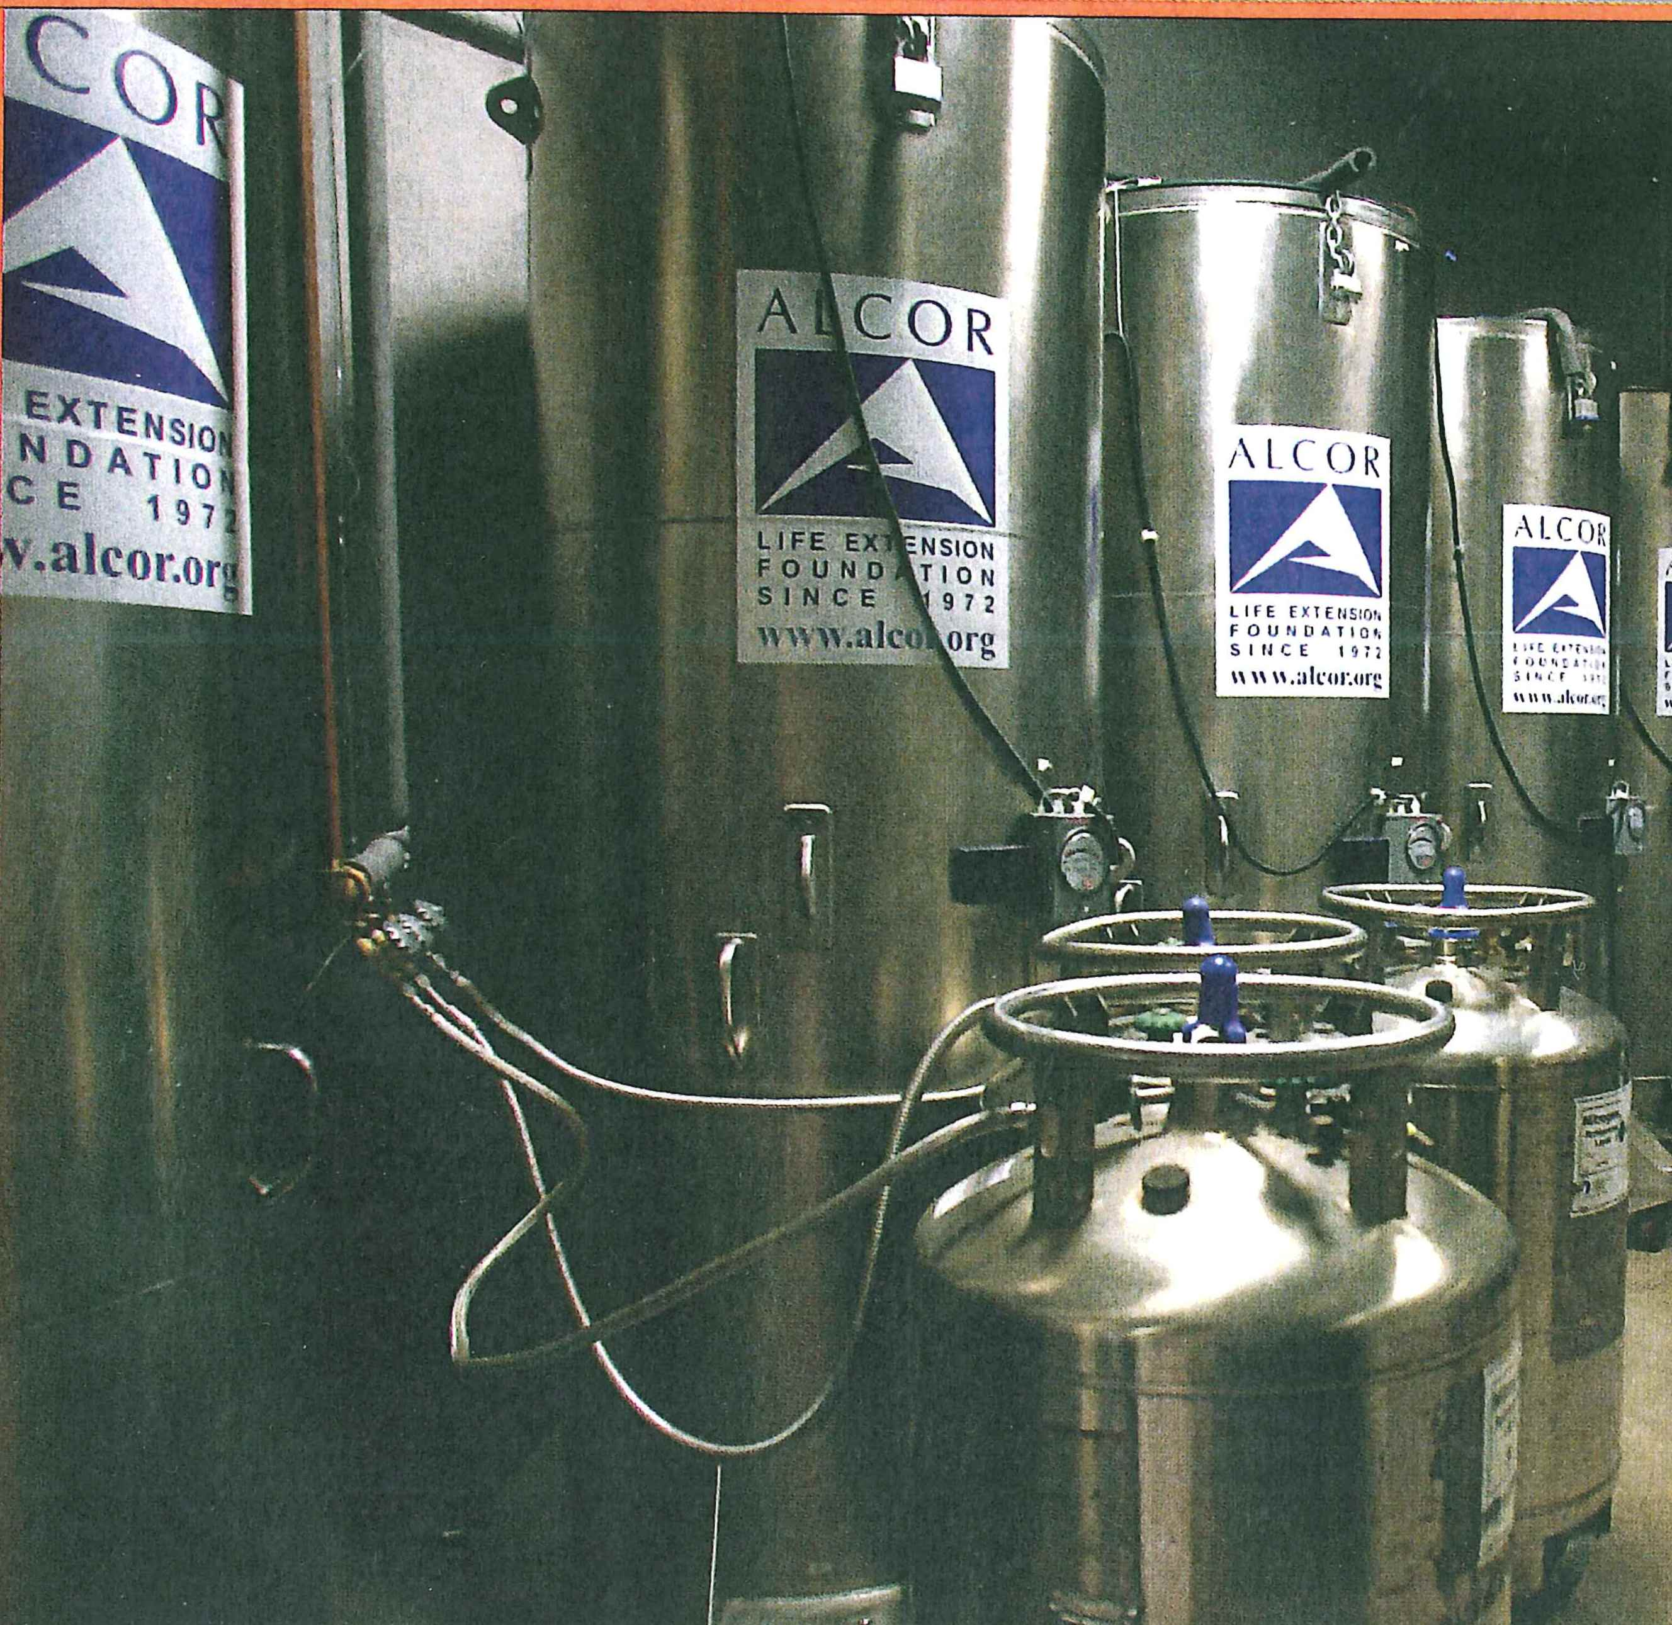
Radical Life Extension- Possible Strategies
Anti-aging drugs
Nanotechnology
Cloning
Cryonics
Genetic Modification
Mind uploading

Slide 18
Resources
Effective Altruists Facebook Page
Giving What We Can Lives You Could Save and Taking the Pledge
When Doing Good Means You're Bad
Separating Warm Fuzzy Feeling from Saving Lives
Living Forever
Anything by Peter Singer…
Me: czabel@stanford.edu

